Slide 1
Object Oriented Computer Programming in C++
Course Code :: CS131303

Slide 2
Polymorphism in C++
Polymorphism
An important concept of object-oriented programming
Simply means having more than one form
In C++, means the same entity (function or object) behaves differently in different scenarios
Example
The + operator in C++ is used to perform two specific functions
When used with numbers, it performs addition
int a = 5; int b = 6; int sum = a + b; // sum = 11
When used with strings, it performs string concatenation
string firstName = "abc "; string lastName = "xyz";
string name = firstName + lastName; // name = "abcxyz"

Slide 3
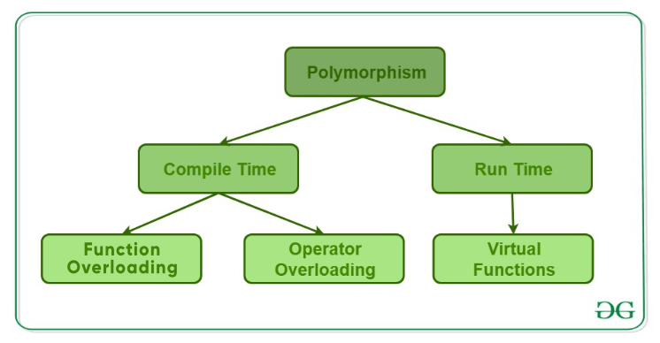
Polymorphism in C++
Polymorphism in C++ is categorized into two types
Compile Time Polymorphism
Runtime Polymorphism

Slide 4
Compile Time Polymorphism
Compile Time Polymorphism
A function or object is called at the time of program compilation
This type of polymorphism is called as early binding or Static binding
Can be achieved by function overloading or operator overloading

Slide 5
Function Overloading
When there are multiple functions
With same name but different parameters
Functions can be overloaded by change in number of arguments or/and change in type of arguments
An overloaded function can perform many tasks

Slide 6
Example :: Function Overloading
#include <iostream>
using namespace std;
class Addition
{
public:
int ADD(int X,int Y)
{
cout << “Result = ” << X + Y;
}
int ADD()
{
string a= "HELLO";
string b=“World !!";
string c= a + b;
cout << c << endl;
}
};
int main()
{
Addition obj;
cout << obj.ADD(10, 20) << endl;
obj.ADD();
return 0;
}
Output:
Result = 30
HELLO World !!

Slide 7
Operator Overloading
C++ also provide option to overload operators
Define additional tasks to operators without changing its actual meaning
Can be done by using operator function
Example
The task is to add two operands
When the operator (‘+’) is used with two strings
It concatenate two strings
When the operator ‘+’ is used with two integer operands
It adds them

Slide 8
Operator that cannot be overloaded
Scope operator (::)
Sizeof
member selector(.)
member pointer selector(*)
ternary operator(?:)

Slide 9
Example :: Operator Overloading
#include <iostream>
using namespace std;
class Addition
{
public:
int ADD(int X,int Y)
{
cout << “Result = ” << X + Y;
}
int ADD()
{
string a= "HELLO";
string b=“ World !!";
string c= a + b;
cout << c << endl;
}
};
int main(void)
{
Addition obj;
cout << obj.ADD(10, 20) << endl;
obj.ADD();
return 0;
}
Output:
Result = 30
HELLO World !!

Slide 10
Run-Time Polymorphism
Run-Time Polymorphism
Functions are called at the time the program execution
Known as late binding or dynamic binding
More flexible as all the things executed at the run time
Can be achieved by Function Overriding

Slide 11
Function Overriding
In function overriding
The new definition to the base class function is given in the derived class
It can be only possible in the derived class
There are two definitions of the same function
One in the super class
The other in the derived class
The decision about which function definition requires calling happens at runtime

Slide 12
Virtual Function
It is part of run time polymorphism
A virtual function is a non-static member function in the base class which is redefined in a derived class
The virtual function must be declared by using the keyword virtual
It is necessary to use a single pointer to refer to all the different classes’ objects
So, there is a need to create a pointer to the base class which can be used to refer all the derived objects
But, when the base class pointer contains the derived class address, the object always executes the base class function
To resolve this problem, the concept the virtual function is used
When a virtual function is declared
The compiler determines which function to invoke at runtime
( i.e., dynamic binding or late binding occurs)

